Slide 2
Harbor Deep Dive
Steven Zou (szou@vmware.com) / core maintainer
Daniel Jiang (jiangd@vmware.com) / core maintainer

Slide 3
Who are we?
Steven (Jia) Zou
Tan (Daniel) Jiang
Core maintainer of open source project Harbor
Staff engineer @ VMware R&D center
Github ID: steven-zou
Core maintainer of open source project Harbor
Software engineer @ VMware
Github ID: reasonerjt

Slide 4

Harbor V1.8.0 is GAed on May 21st

Slide 5

Agenda
Harbor Overview
Highlights in Latest Version V1.8
Roadmap
Harbor Community

Slide 6












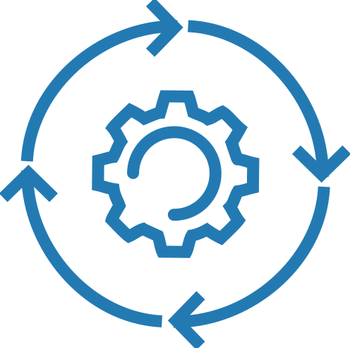
Typical Serving Scenario of Harbor
Region 1
Region 2
Region 3
Scan/Trust
REPLICATION
Code Commits
On-premise Node
Registry Node 1
Registry Node 2
Registry Node 3
Publish
Pull Images
Pull Images
Pull Images
Rep
Rep
Runtime
Runtime
Runtime
Dev
QE
Staging
Kubernetes Cluster
Kubernetes Cluster
CD
Kubernetes Cluster
CI
TUNNEL
K8S API
VM
VM
VM
VM
VM
VM
VM
VM
VM
Code Repository
Build Engine

Slide 7
Harbor Overview

Slide 8

An open source trusted cloud native registry project.
goharbor.io

Slide 9


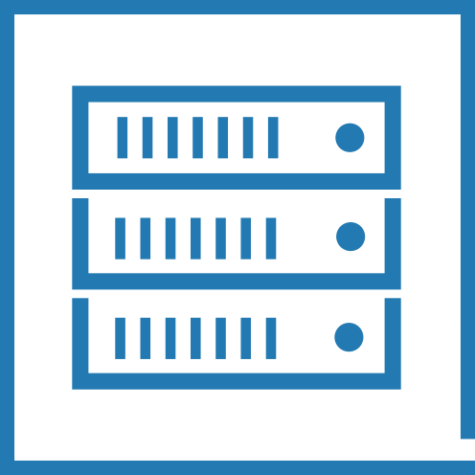

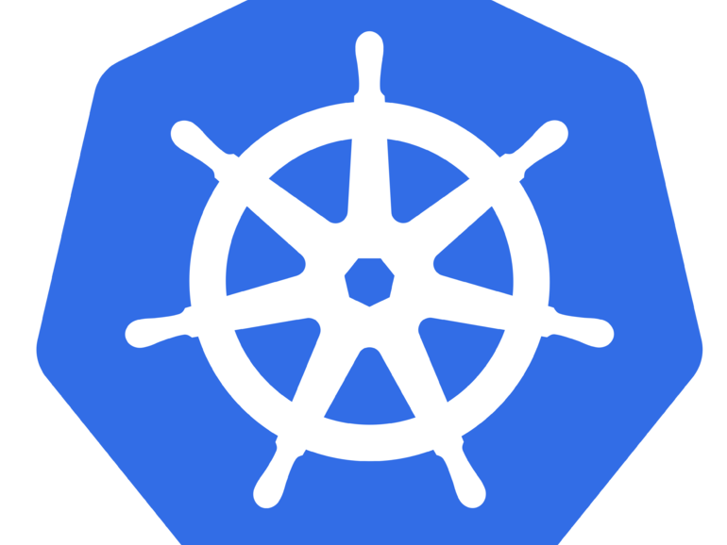





Fundamentals
Upstream
OIDC
LDAP/AD
Container Image Management
Multi Backend Storages
Multi Consumers
Identity Integrations
1.8
Angular 6
Swagger
community
Helm Chart Management
Web Portal
REST API
CLI

Slide 10

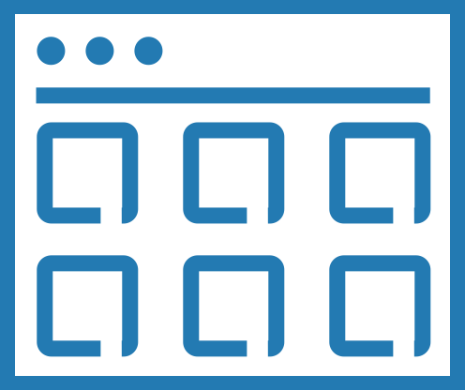






Security
Project
RBAC
3rd: Clair
Namespace Isolation
Access Control
Vulnerability Scanning
Signature
Audit
Vuln Status
3rd: Notary
Distribution Policy
Access Log
Content Trust

Slide 11




Operation
Pull/Push
Read-Only
Robot Account
1.8
Online GC
Health API
NG
Health Check
1.8
Replication
1.8

Slide 12


Deployment
Compose
HA
BOSH Release
Chart
Deployment
1.8
Docker
Kubernetes
Cloud foundry

Slide 13
Highlights in Latest V1.8

Slide 14






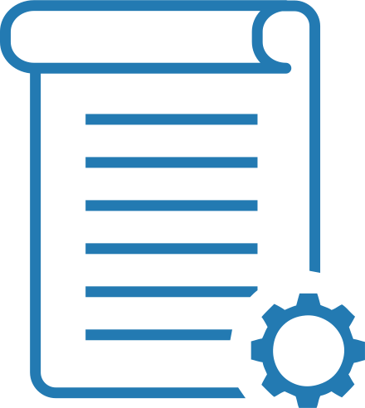



Replication NG
Design Refactor
>85% code rewrite
Harbor<->Non-Harbor
Image + Chart
Pull/Push Mode
Triggers
Filters
V2 Compatible Supported
Policy Based
Docker Hub
Docker Distribution
Huawei Container Registry
(SWR)

Slide 15
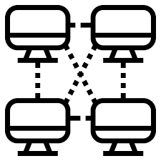





Replication NG – Future
Performance
P2P
ECR
GCR
ACR
Ali-ACR
Efficiency
Replication Group

Slide 16
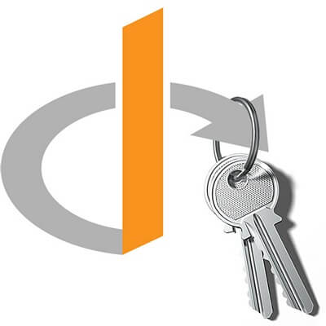





OIDC
Open ID Spec
Configurable Providers
Web SSO
Docker CLI Secret

Slide 17




OIDC - Providers
End User Verified
Keycloak
Google Identity
Dexidp/dex
Ping Identity
Other OpenID Compatible Providers

Slide 18
Roadmap

Slide 19
Michael Michael / @michmike
Harbor Core maintainer
Director of Product Management, VMware

Slide 20

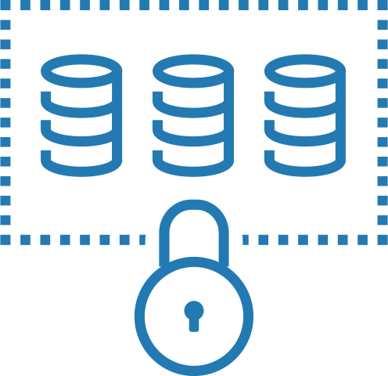
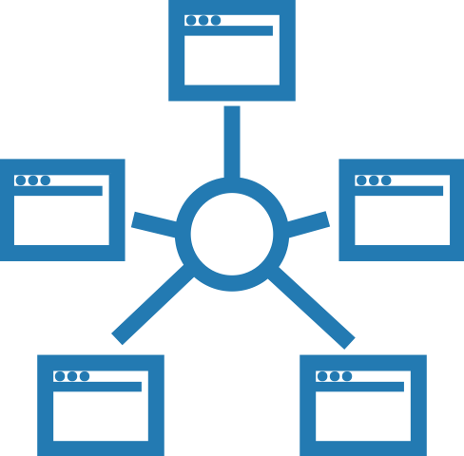







Roadmap
Management
Label Import &
Management
Kubernetes Operator
Project Quotas
Logging Endpoint
Perf & Scale
Extensibility
Repository Beyond image/Helm with git
Webhook
Interrogation Service
Proxy Cache
P2P Distribution

Slide 21
Harbor Community

Slide 22
We’re trying to build an open, fair, transparent and self-government community

Slide 23



Harbor Community
Stars
Forks
Commits
7900+
2200+
6700+

Slide 24






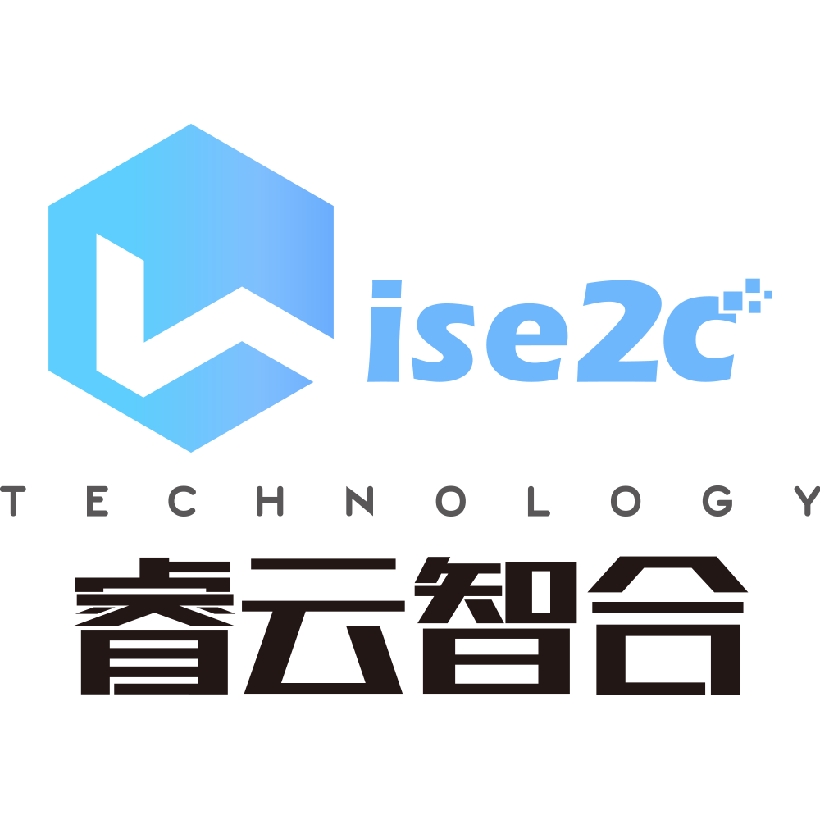















Harbor Users and Partners (selected)
x
x
Source: https://github.com/goharbor/harbor/blob/master/ADOPTERS.md

Slide 25


Global Contributions
Canada
Sweden
Russia
UK
Belarus
Germany
France
Ukraine
USA
Spain
Italy
China
Korea
Japan
India
Vietnam
14 Maintainers
Nicaragua
5 Companies
Brazil
Singapore
South Africa
Australia
126 Contributors
New Zealand
65+ Companies
36+ Countries
Source: https://harbor.devstats.cncf.io

Slide 26

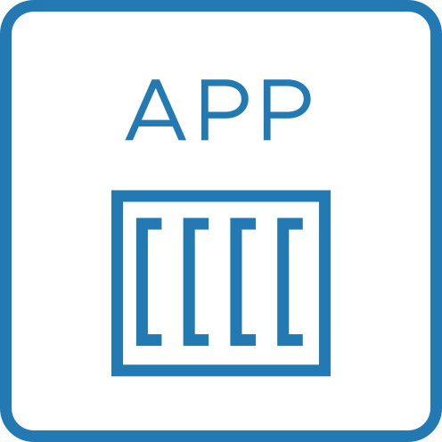


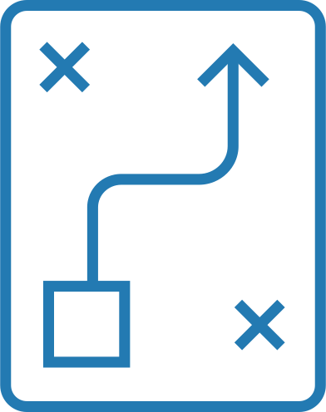


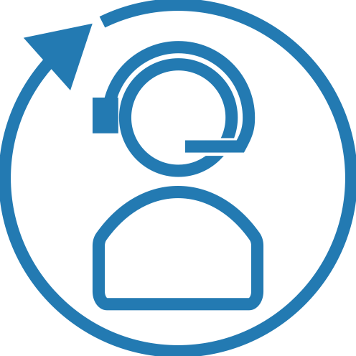

Levels of Participation
Governance Model
End User
Contributor
Maintainer
Contributing
Guide
1st Commit
Fix Bugs
Commits
Reviews
Release Plans
GitHub Issues
Experiences Sharing
Community Meetings
Governance Model
Proposal
Community Meetings
Presentations
Host Meetings

Slide 27






More ways to get involved​
slack.cncf.io
harbor-users@lists.cncf.io
harbor-dev@lists.cncf.io
#harbor
#harbor-dev
https://demo.goharbor.io
Username: admin
Password: Harbor12345
@project_harbor
https://github.com/goharbor/community/blob/master/MEETING_SCHEDULE.md (bi-weekly)
APAC+EU zone: 9pm UTC+8 time zone
America+EU zone: 1pm Pacific time zone

Slide 28

Thank you very much!
Q&A

